Slide 1
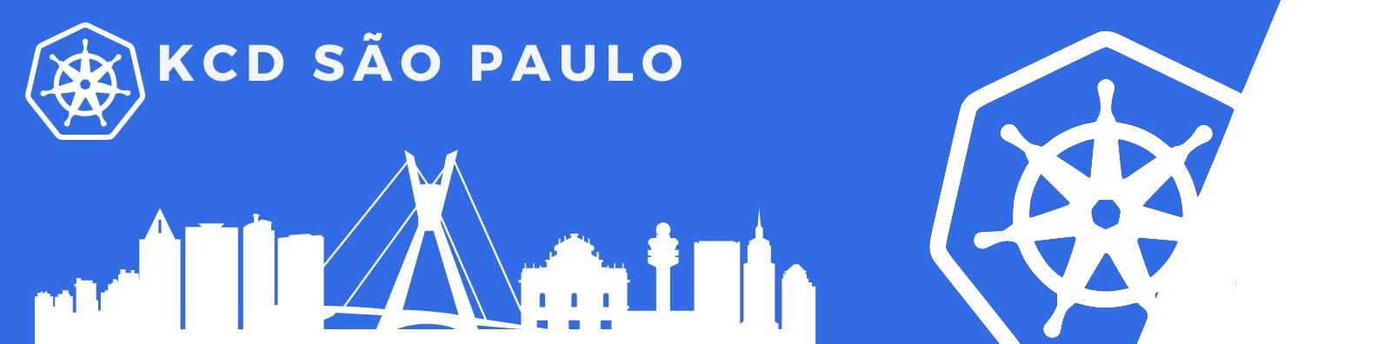
Scalable SaaS deployments on Kubernetes with GitOps
Rodrigo Bersa
Lucas Duarte
Sr. Container Specialist SA Amazon Web Services
Sr. Container Specialist SA
Amazon Web Services

Slide 2

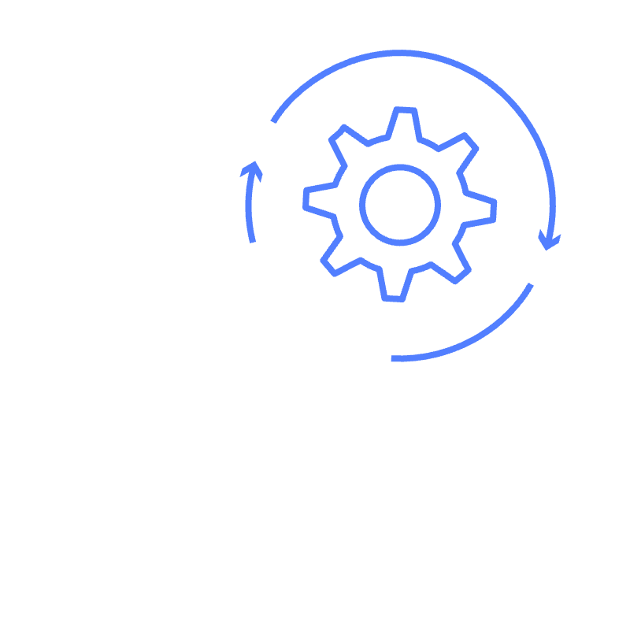
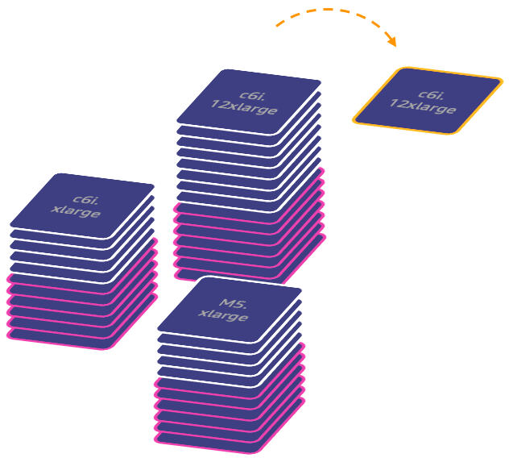
What is SaaS?
Software as a Service (SaaS) is a cloud-based software model that delivers applications to end-users on-demand
Deployment and Infra management
Scalability and Elasticity
Revenue Model
Notes:
Deployment: Traditional software requires installation on the user's hardware, whereas SaaS applications are accessed through the internet, eliminating the need for local installation. Software as a Service (SaaS) is a cloud-based software model that delivers applications to end-users through an internet browser. SaaS vendors host services and applications for customers to access on-demand:
Deployment and Infra management: Customers don’t need to manage their own servers and applications, don’t needing to worry about maintenance and updates.
Scalability and Elasticity: Customers don’t need to worry about scalability needs, but scaling is one of the most challenge aspects for a SaaS Provider.
Revenue Model: SaaS typically relies on a subscription-based revenue model, which can provide a steady income stream and can be scaled based on the service tiers (tenant model).

Slide 3
Different Tenant Models
Pool Tenants
Silo Tenants
Hybrid Tenants
SaaS
SaaS
SaaS
SaaS
SaaS
Notes:
As a SaaS provider, you might want to offer different tiers for your application, and depending on each tier, you can adjust access to features, support levels, and resource limits. Each customer using your service is a 'tenant'. Higher tiers could include advanced features, more storage, or better support, while lower tiers might be more basic, catering to smaller or budget-conscious users.

Slide 4
DevOps and SaaS
Agility
Operational efficiency
Tenant onboarding
automation
DevOps supports scale and growth

Slide 5
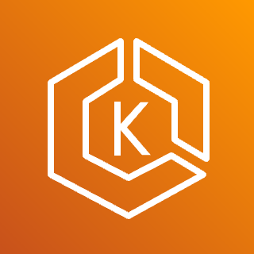


SaaS DevOps challenge
SaaS application plane
SaaS control plane
Amazon EKS cluster
Shared services
Pool namespace (n-tenants)
Product
Order
Shipping
Payment
Product
Onboarding
Tenant User
Silo namespace (tenant-1)
Product
Order
Shipping
Payment
Product
User
Management
Tenant
Management
Silo namespace (tenant-2)
Developer
Product
Order
Shipping
Payment
Product
DevOps and provisioning
SCM (git)
Tenant
Provisioning
Hybrid namespace (tenant-3)
Product
Product
Order
Payment
Order
Shipping
CI/CD
Silo namespace (tenant-4)
Product
Order
Shipping
Payment
Payment

Slide 6
Problem statement recap
Hybrid and silo models require provisioning of new resources
Tenant provisioning must deploy latest version, and apply tier/pod based configurations
Code deployments update all tenant environments
These things can happen in parallel

Slide 7





Building blocks
Template
Deployment
Automation
Toolset
Release
config
Environment repository
Executes steps to create and update tenant environments
The tenant environment
blueprint
Instance of tenant environment template with configuration
Stores release config objects for all environments

Slide 8



Basic flow
Tenant provisioning /
code deployment
Deployment Automation Toolset
create
update
1
read
2
read
3
4
deploy
Template
Environment repository
Release configuration
Tenant / Tier environments

Slide 9
SaaS GitOps solution

Slide 10
Why GitOps?
Scan
Deploy/Verify
Git becomes the single source of truth for the desired system state, allowing for reproducible automated deployments, cluster management, and monitoring.
Test
Observe/Alert
Build
Operate/Fix
Immutability Firewall

Slide 11

SaaS GitOps overview
Git repo
Microservice source
Continuous Integration (CI)
Container Image
Microservice source (v2)
Continuous Integration (CI)
Container Image
Environment template
1.0.0
1.1.0
commits
Microservice source
Continuous Integration (CI)
Container Image
Developers
Release Config
1.x.x
deployment_config: {
“model”: “Silo”,
“tenantID”: “1”,
“config”: {}
}
writes
deployment_config: {
“model”: “Pool”
“tenantID”: “2”,
“config”: {}
}
Provisioning
triggers
Argo Workflow
writes
Release Config
Deploy
infrastructure
1.x.x
AWS Cloud
Infrastructure resources
Reconcile application
Amazon EKS Cluster
FluxV2

Slide 12
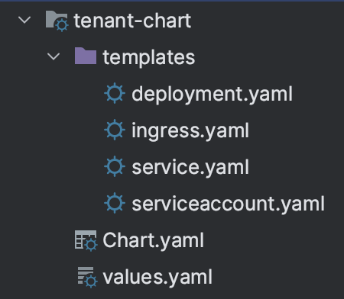
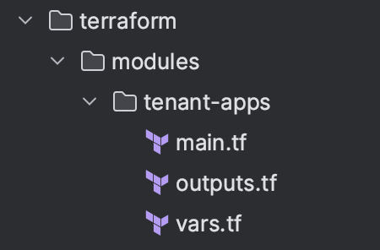
Tenant environment template
Baseline app
template
Application
Package
Continuous Integration (CI)
updates
Infrastructure
Package

Slide 13
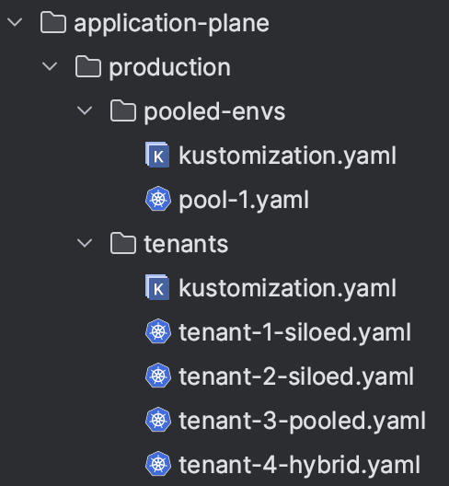
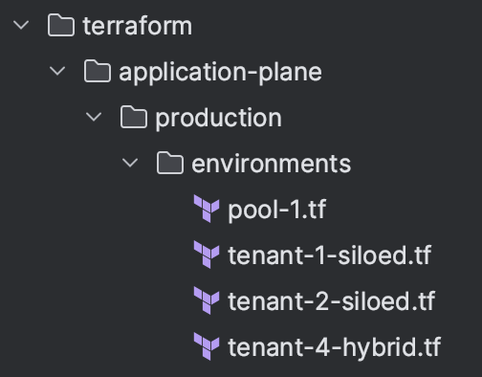
Release config
Release repository
Application
Release
writes
Argo Workflow
Infrastructure
Release

Slide 14
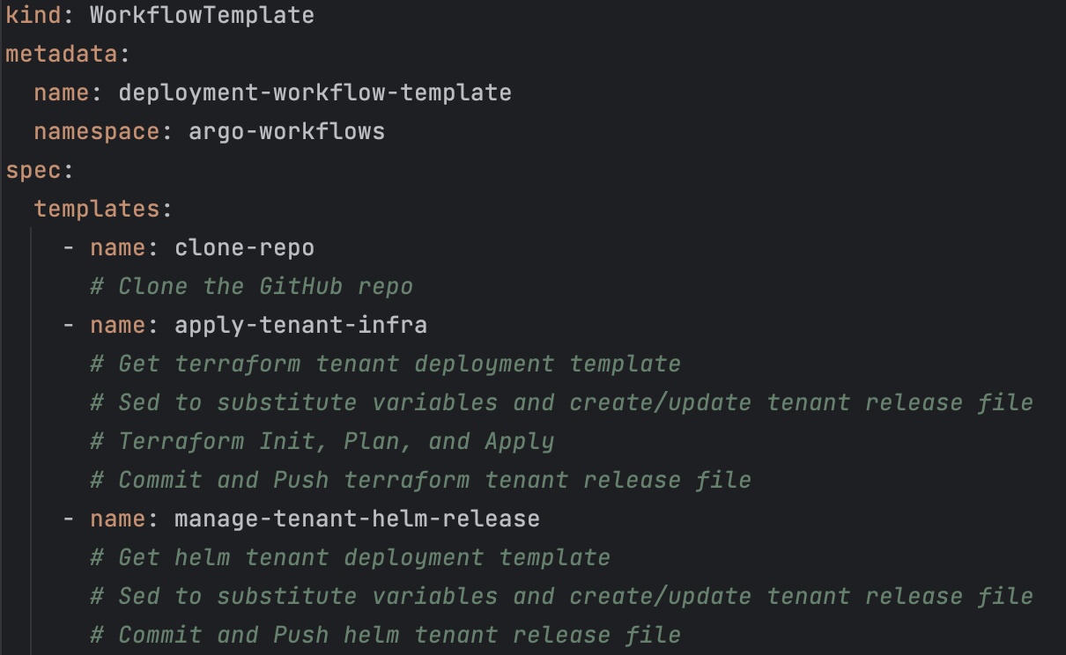

Argo Workflows
Git repo
read
Release
observes
FluxV2
Argo Workflow
write
deploys
AWS Cloud
Amazon EKS Cluster
Namespace
Namespace
Namespace
deploys
Amazon Simple Storage Service (S3)
Amazon Simple Queue Service
Amazon DynamoDB

Slide 15
Demo

Slide 16



Key takeaways
Package tenant
deployment definitions
Consider options that are immutable/versioned
Frequent releases & consistent environments
Successful SaaS applications require frequent releases
and consistent environments

Slide 17

Like to know more? Contact us !

Slide 18

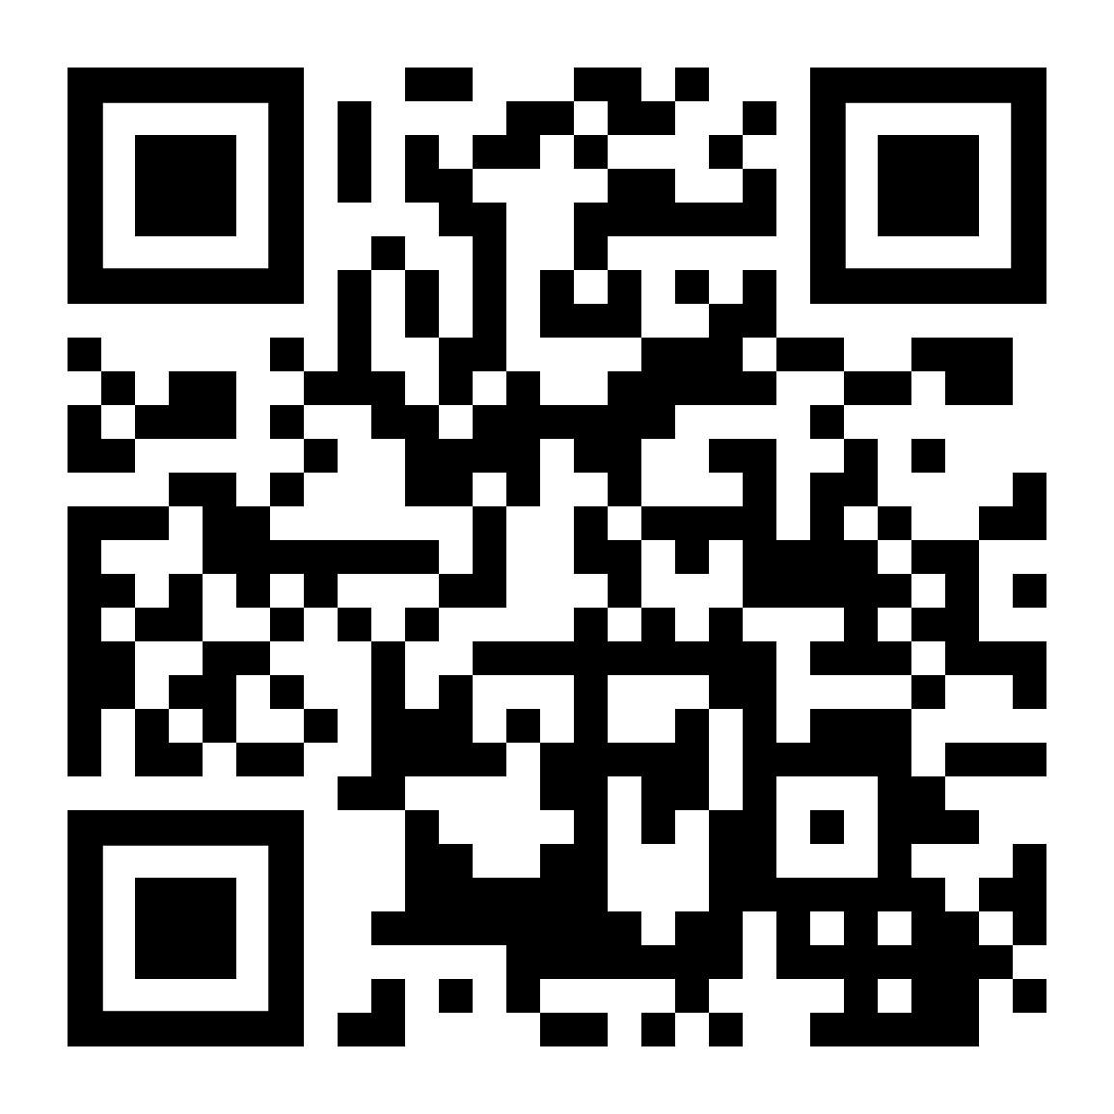
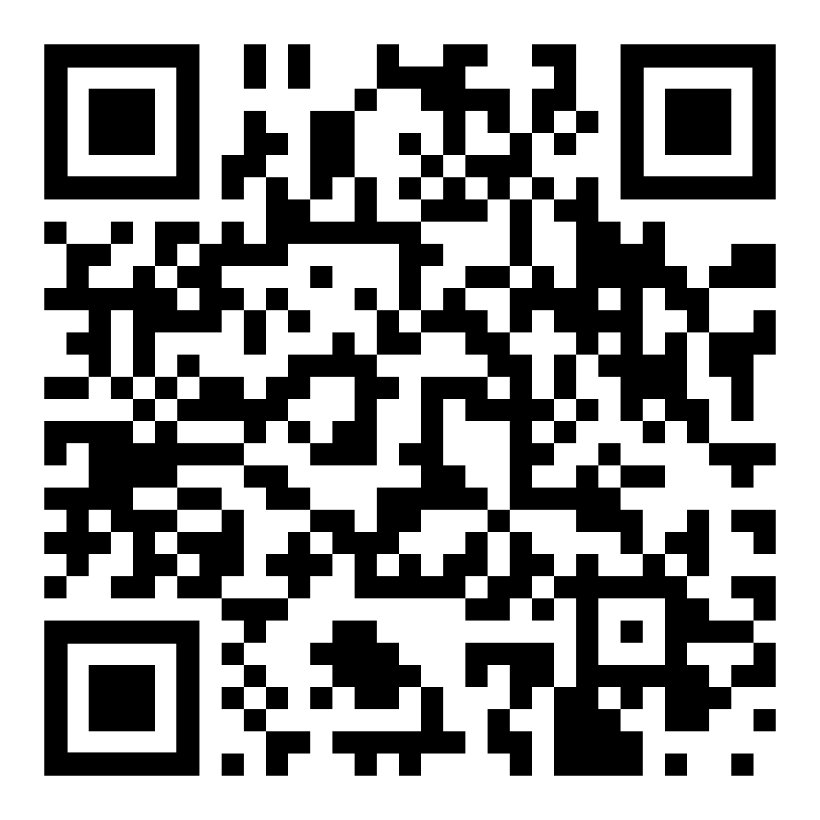
Rodrigo Bersa
Lucas Duarte
bersa
lucas-soriano-alves-duarte

